Slide 2



Grazie ai nostri sponsor

Slide 3
What’s New in Xamarin.Forms
Matteo Pagani
Windows AppConsult Engineer @ Microsoft
matteo.pagani@microsoft.com | Twitter: @qmatteoq

Slide 4














Your platform for building anything
DESKTOP
WEB
CLOUD
MOBILE
GAMING
IoT
AI
.NET

Slide 5

Xamarin: Anything you can do in Objective-C, Swift, or Java, you can do in C# and Visual Studio
Native user interface
High-fidelity API access
Native performance

Slide 6

.NET for Mobile Apps
iOS APIs
Android APIs
Windows APIs
Shared C# logic
Shared C# codebase • 100% native API access • High performance

Slide 7

.NET
Everywhere
Device native
.NET
Cloud native
.NET Everywhere
.NET STANDARD LIBRARY

Slide 8
The tools

Slide 9
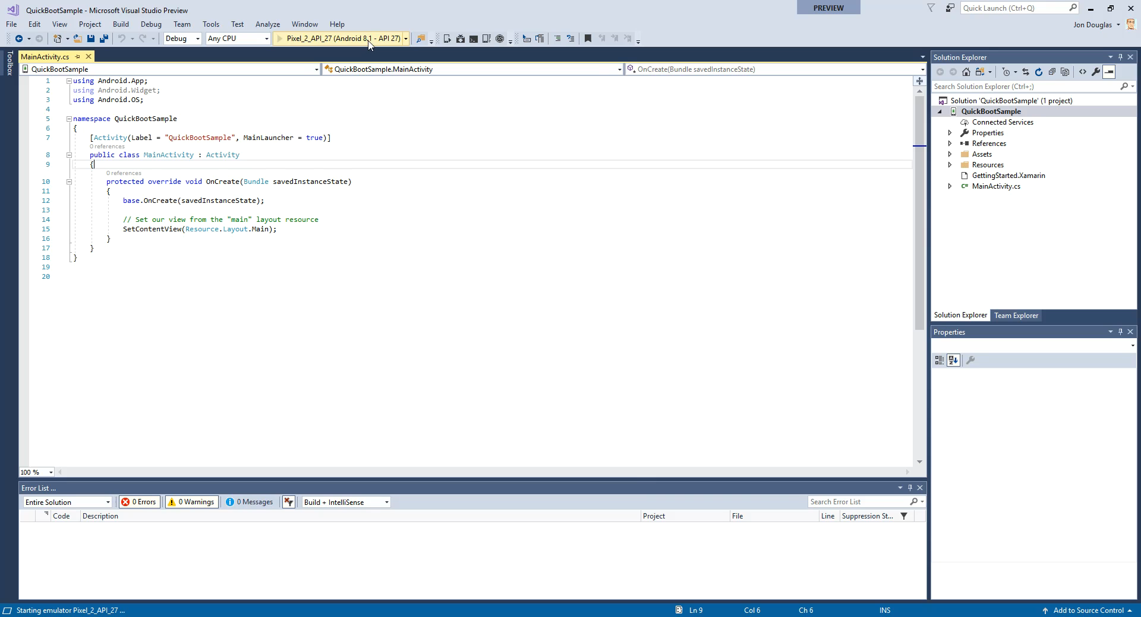
Android Emulator – Hyper-V + Quick Boot

Slide 10
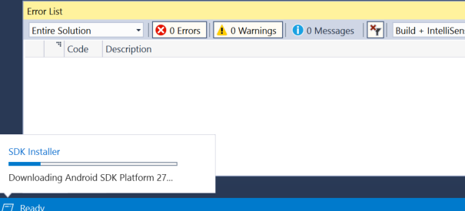
Automatic SDK Management

Slide 11
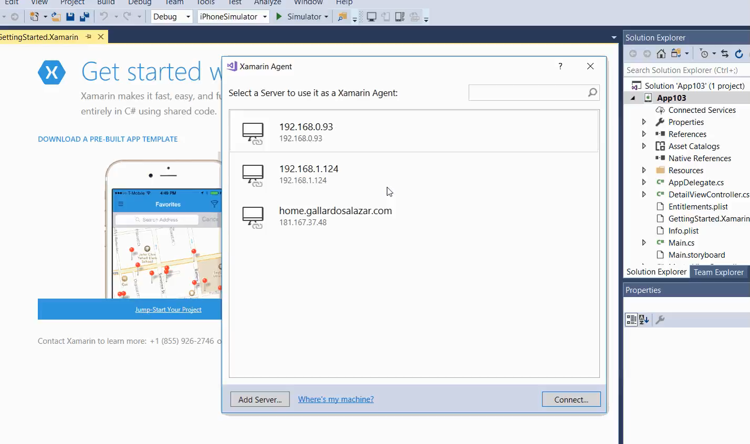
Provisioning your Mac

Slide 12
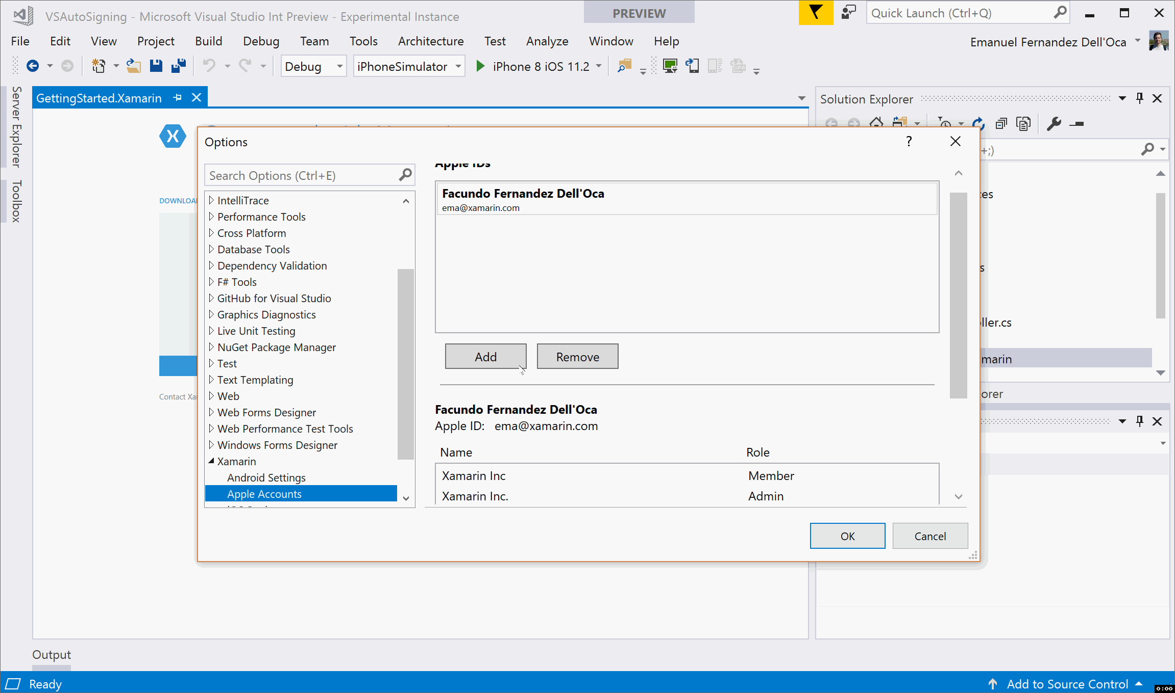
Automatic Device Provisioning

Slide 13
The platform

Slide 14
XAMLC and Compiled Bindings
Perf
[assembly: XamlCompilation (XamlCompilationOptions.Compile)]
Namespace MyApp { ….
<ListView x:Name="colorListView"
Grid.Row="0"
ItemsSource="{x:Static local:NamedColor.All}"
RowHeight="40">
<ListView.ItemTemplate>
<DataTemplate x:DataType="{x:Type local:NamedColor}">
<ViewCell>
<StackLayout Orientation="Horizontal">
<BoxView Color="{Binding Color}"
HeightRequest="32"
WidthRequest="32"
VerticalOptions="Center" />

Slide 15
Android Fast Scrolling
Perf
<ContentPage
xmlns="http://xamarin.com/schemas/2014/forms" xmlns:x="http://schemas.microsoft.com/winfx/2009/xaml" x:Class="TheLittleThingsPlayground.Views.ItemsPage" Title="{Binding Title}" x:Name="BrowseItemsPage" xmlns:android="clr-namespace:Xamarin.Forms.PlatformConfiguration.AndroidSpecific;assembly=Xamarin.Forms.Core"> <ContentPage.Content> <StackLayout> <ListView x:Name="ItemsListView" android:ListView.IsFastScrollEnabled="true"
…
</ContentPage>

Slide 16
Android Fast Renderers
Perf
Button, Image, Label
<Button />
Default
Fast Renderer
ButtonRenderer
AppCompatButton
AppCompatButton

Slide 17
Forms.SetFlags("FastRenderers_Experimental"); Forms.Init(this, bundle);
Notes:
apply this to your ContentPage
Device.FlowDirection is a helper to get the device direction based on language and region choices
inherited by children. Can be overriden.

Slide 18
Layout Compression
Perf
ContentPage
2 3 4 5 6 7 | <StackLayout Spacing="0" CompressedLayout.IsHeadless="true" VerticalOptions="FillAndExpand" HorizontalOptions="FillAndExpand"> <Grid CompressedLayout.IsHeadless="true”> ... </Grid> ... </StackLayout>
StackLayout
Grid
Label
Label
Label
ListView

Slide 19
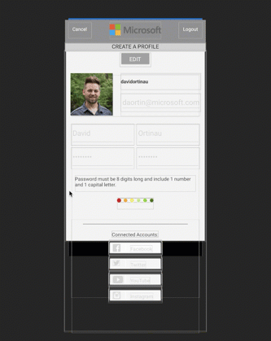
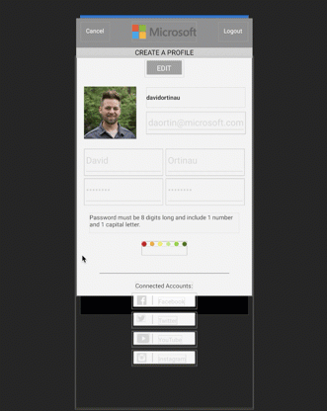
Uncompressed
130 Views
Compressed
111 Views
Compressed + Fast Renderers
70 Views

Slide 20
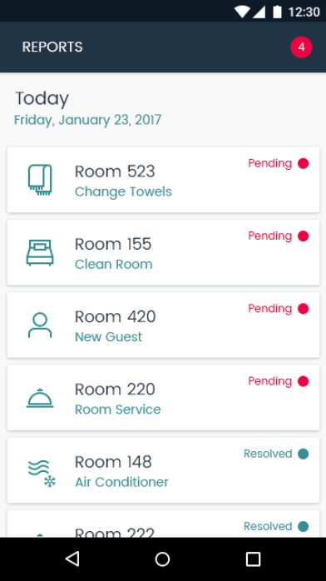
Native Forms
// Minimal setup 1x before instantiating a ContentPage
Xamarin.Forms.Forms.Init();
var settingsView = new SettingsView
{
BindingContext = settingsViewModel
};
var settingsController = settingsView.CreateViewController();
NavigationController.PushViewController(settingsController, true);

Slide 21
Native Forms Demo

Slide 22
LTR
RTL

Slide 23
FlowDirection="{x:Static Device.FlowDirection}"
Notes:
apply this to your ContentPage
Device.FlowDirection is a helper to get the device direction based on language and region choices
inherited by children. Can be overriden.

Slide 24
FlexLayout
Flexbox inspired layout system
Prioritizes distribution and alignment
Great for adaptive layouts – multiple form factors
Promotes flatter layout, reducing UI nesting

Slide 25
CSS
Styles expressed via Cascading Style Sheets (CSS)
Parsed a runtime
Does not replace XAML Styles
Supports many properties
But not all…
Styles are applied one by one, in definition order
Styles defined on the item itself is always applied last

Slide 26
Visual State Manager
<Entry FontSize="18">
<VisualStateManager.VisualStateGroups>
<VisualStateGroup x:Name="CommonStates">
<VisualState x:Name="Normal">
<VisualState.Setters>
<Setter Property="BackgroundColor"
Value="Lime" />
</VisualState.Setters>
</VisualState>
<VisualState x:Name="Focused">
<VisualState.Setters>
<Setter Property="FontSize"
Value="36" />
</VisualState.Setters>
</VisualState>
<VisualState x:Name="Disabled">
<VisualState.Setters>
<Setter Property="BackgroundColor"
Value="Pink" />
</VisualState.Setters>
</VisualState>
</VisualStateGroup>
</VisualStateManager.VisualStateGroups>
</Entry>
VisualElement ”CommonStates”
Normal
Focused
Disabled
GoToState(this, “Focused”);

Slide 27
FlexLayout and Visual State Manager Demo

Slide 28
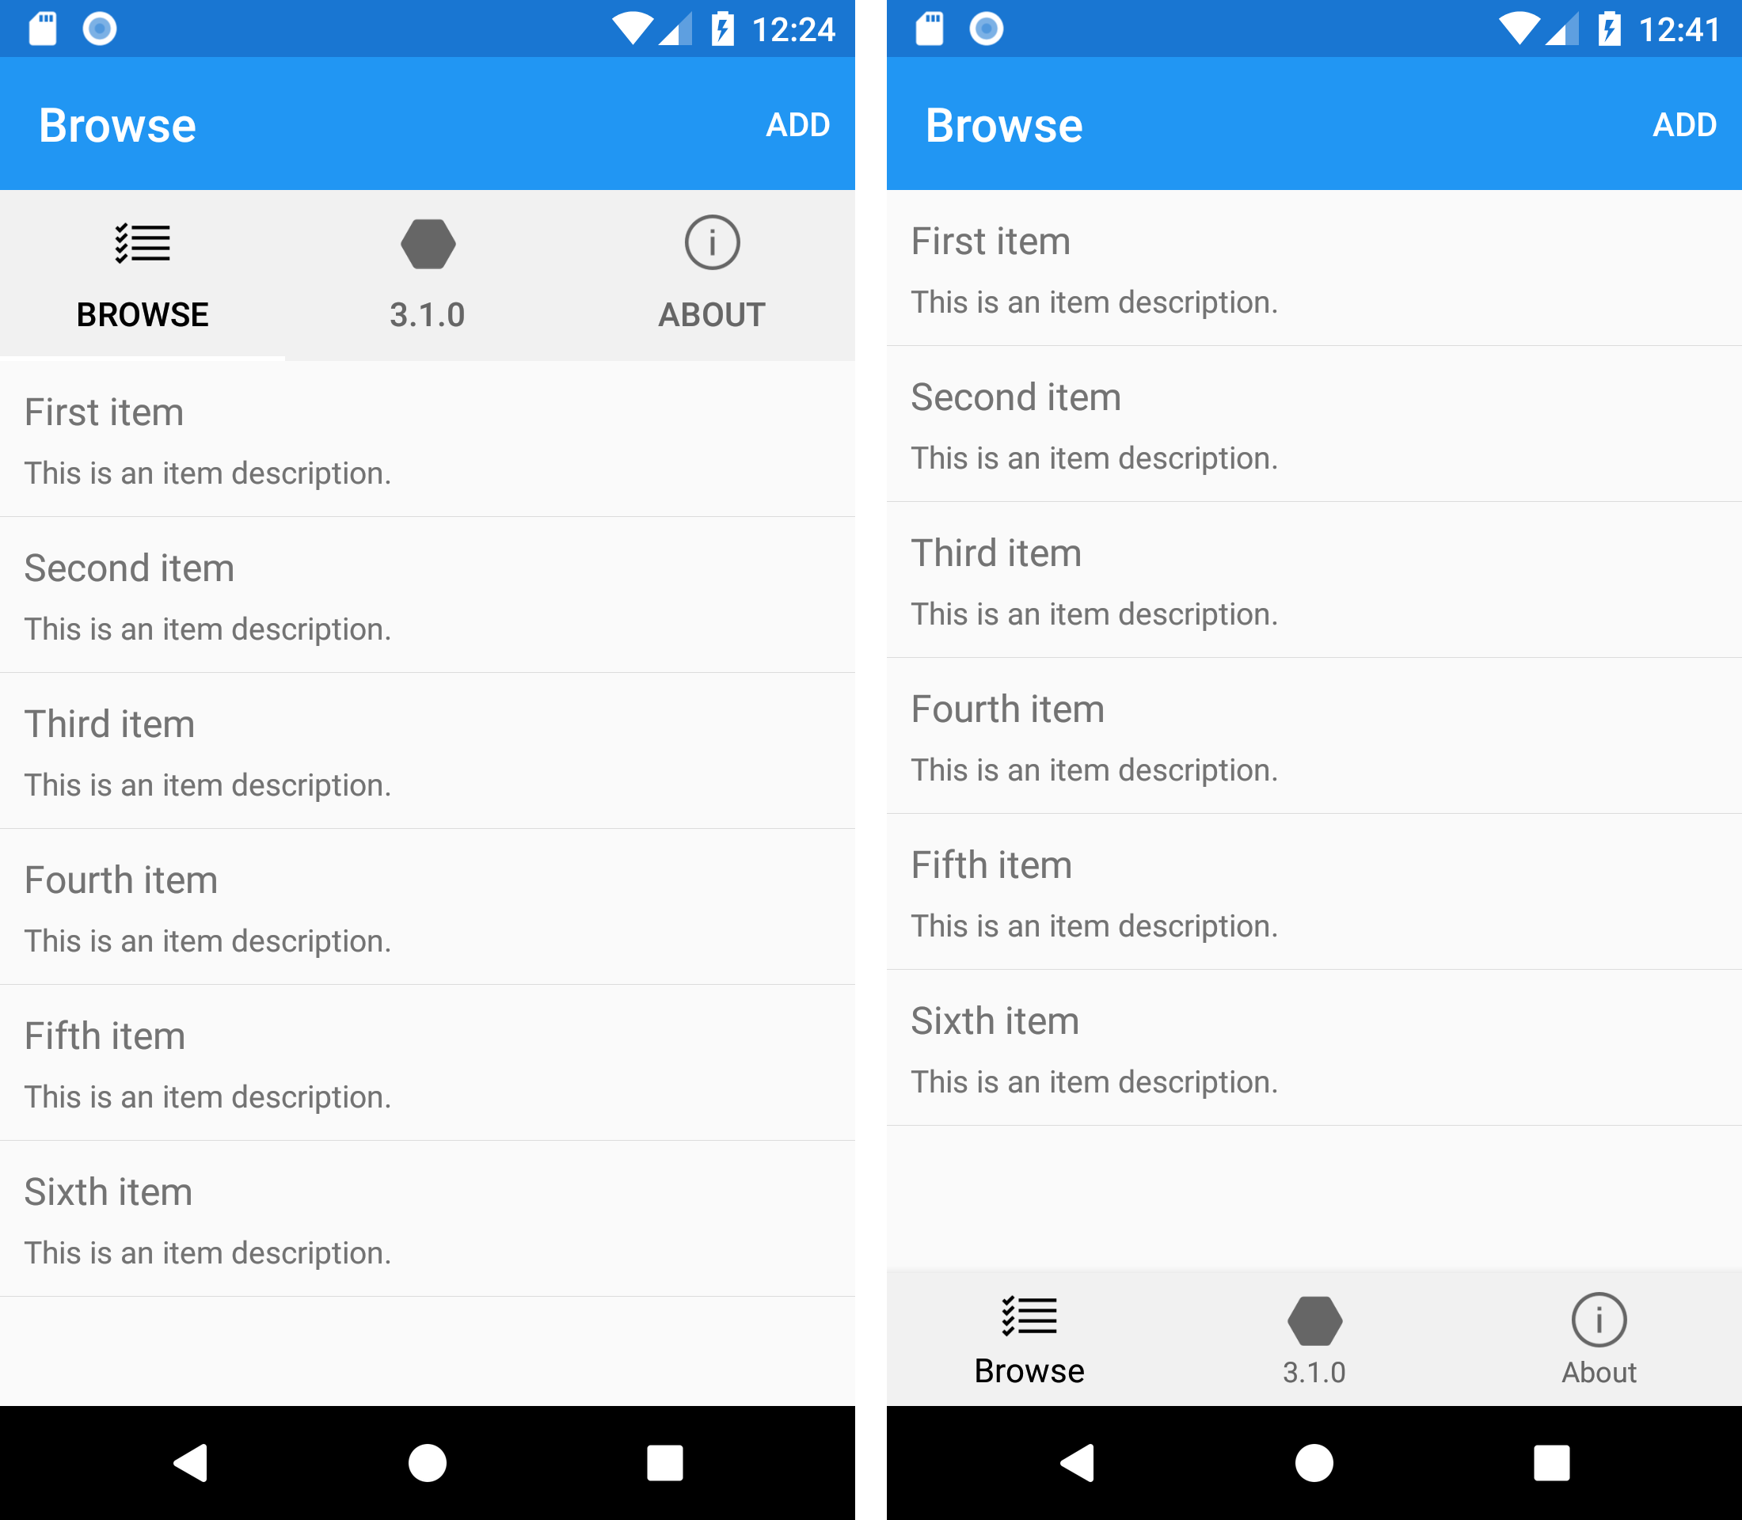
Android Bottom Tabs
1 2 3 4 5 6 7 8 9 | <TabbedPage … BarBackgroundColor="#F1F1F1" xmlns:android="clr-namespace:Xamarin.Forms.PlatformConfiguration.AndroidSpecific;assembly=Xamarin.Forms.Core" android:TabbedPage.ToolbarPlacement="Bottom" android:TabbedPage.BarItemColor="#666666" android:TabbedPage.BarSelectedItemColor="Black">

Slide 29
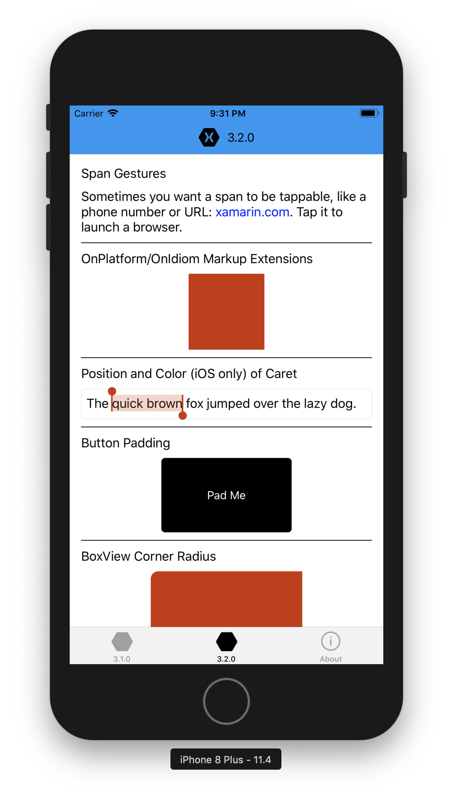
TitleView
<ContentPage>
<NavigationPage.TitleView>
<StackLayout
Orientation="Horizontal"
VerticalOptions="Center" Spacing="10">
<Image Source="iconXamagon.png">
<Image.GestureRecognizers>
<TapGestureRecognizer
Tapped="Handle_Tapped"/>
</Image.GestureRecognizers>
</Image>
<Label Text="3.2.0"
FontSize="16"
TextColor="Black"
VerticalTextAlignment="Center" />
</StackLayout>
</NavigationPage.TitleView>
...
</ContentPage>

Slide 30
OnPlatform & OnIdiom XAML Extensions
Concise syntax
Supports Default value
Support Converter and ConverterParamter
<BoxView
FlexLayout.AlignSelf="Center"
WidthRequest="100"
HeightRequest="100"
BackgroundColor="{OnPlatform Android=#333333, iOS=#CC3300, Default=Green}" />

Slide 31
Span enhancements
<Label>
<Label.FormattedText>
<FormattedString>
<Span Text="Sometimes you want a span to be tappable, like a phone number or URL: " />
<Span Text="{Binding Url, Mode=OneWay}" TextColor="Blue“ TextDecorations="Underline">
<Span.GestureRecognizers>
<TapGestureRecognizer
Command="{Binding TapCommand, Mode=OneWay}"
CommandParameter="https://www.xamarin.com"/>
</Span.GestureRecognizers>
</Span>
<Span Text=". Tap it to launch a browser."/>
</FormattedString>
</Label.FormattedText>
</Label>

Slide 32
New WebView in iOS
Xamarin Forms renders the WebView in iOS using the UIWebView control
It provides the best compatibility, but it’s a bit outdated
You can opt-in to use the new WKWebView, which runs in a separate process and provides better performance
[assembly: ExportRenderer(typeof(WebView), typeof(WKWebViewRenderer))]

Slide 33
Geolocation
Geolocation
Geolocation
Shared C# Backend
Compass
Compass
Compass
Keystore
Keystore
Keystore

Slide 34
Preferences.Get(“my_key”, 0);
NSUserDefaults
SharedPreferences
ApplicationData
Notes:
Here is an example of getting preferences:

Slide 35

Xamarin.Essentials
Secure Settings
Sms
Preferences
Flashlight
Clipboard
Gyroscope
Magnetometer
Geolocation
Phone Dialer
Device Display Info
Email
Device Info
Battery
Compass
Accelerometer
Screen Lock
Data Transfer
Text to Speech
Geocoding
File System
Connectivity
Vibration
aka.ms/xamarinessentials

Slide 36
Xamarin.Essentials Demo

Slide 37
What’s next?

Slide 38
CollectionView
Perf
ListView but better
RecyclerView on Android
You provide the layout
Grid
Horizontal
Vertical
FlexLayout (?)
Context Menus
Gestures

Slide 39
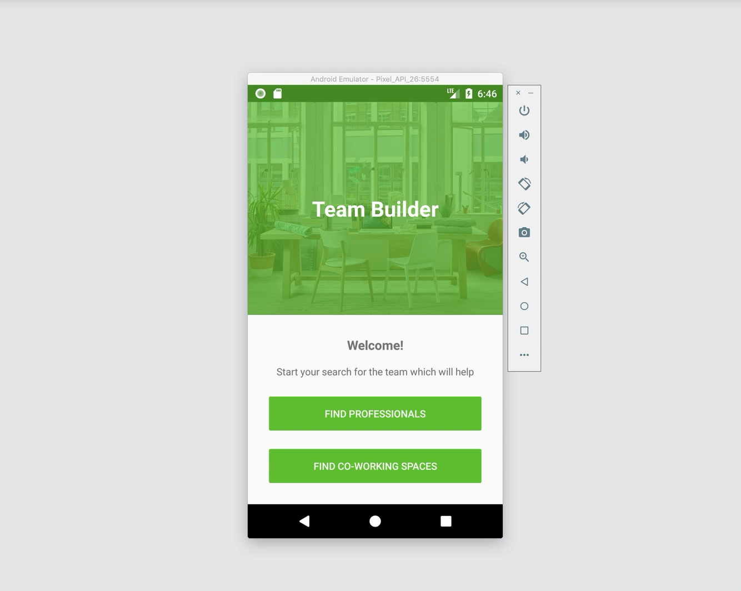
Demo – CollectionView

Slide 40
<CollectionView x:Name="Spaces" Margin="0,5,0,0”/>
Spaces.ItemsLayout = new GridItemsLayout(2, ItemsLayoutOrientation.Vertical);
Spaces.ItemTemplate = new DataTemplate(() => new SpaceCard());
Spaces.ItemsSource = items;

Slide 41
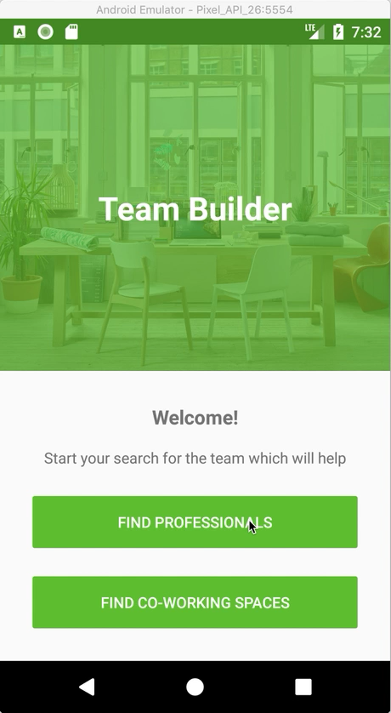
Demo – CarouselView

Slide 42
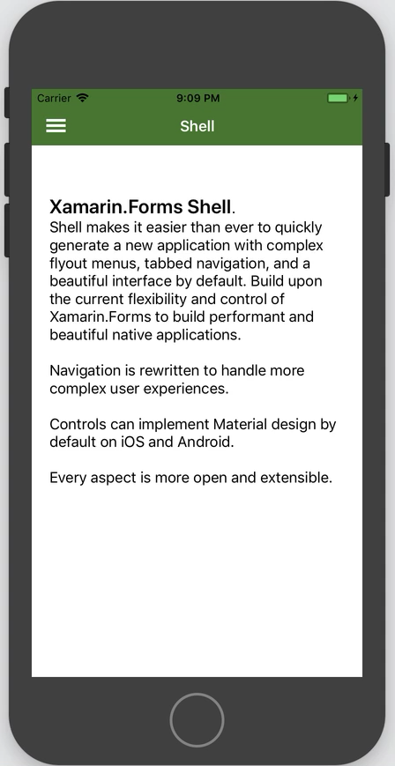
Xamarin.Forms Shell
Perf
Performant by default
Same design on iOS and Android via MaterialShell
Platform design via Shell
Easily describe your entire app in one file
Flyout and Tabbed navigation
URL routed navigation, deep linking
Back navigation handling
Integrated Search handler
Snackbar
Bottom Sheet
Floating Action Button
Left Bar Button
Screen segues
Screen transitions
Plus everything you can already do today in Xamarin.Forms

Slide 43
<?xml version="1.0" encoding="UTF-8"?>
<Shell xmlns=…>
<Shell.Resources>
<ResourceDictionary Source="Styles/Global.xaml"/>
</Shell.Resources>
<ShellItem Route="main" Title="Home">
<ShellSection Route="home" Title=“Home”>
<ShellContent ContentTemplate="{DataTemplate local:MainPage}" />
</ShellSection>
<ShellSection Route="activity" Title="Activity">
<ShellContent Route="shared" Title="Shared" ContentTemplate="{DataTemplate local:ActivityPage}" />
<ShellContent Route="notifications" Title="Notifications" ContentTemplate="{DataTemplate local:NotificationsPage}" />
</ShellSection>
<ShellSection Route="updates" Title="Updates">
<ShellContent ContentTemplate="{DataTemplate local:UpdatesPage}" />
</ShellSection>
</ShellItem>
</Shell>
Notes:
Concept Description
A simple statement (“elevator pitch”) that describes your concept. It’s okay if the description doesn’t completely describe the concept.
The participant’s questions, at this point, help highlight the details about the concept that the participant cares most about.
Ideally, your description should be no more than two sentences.

Slide 44
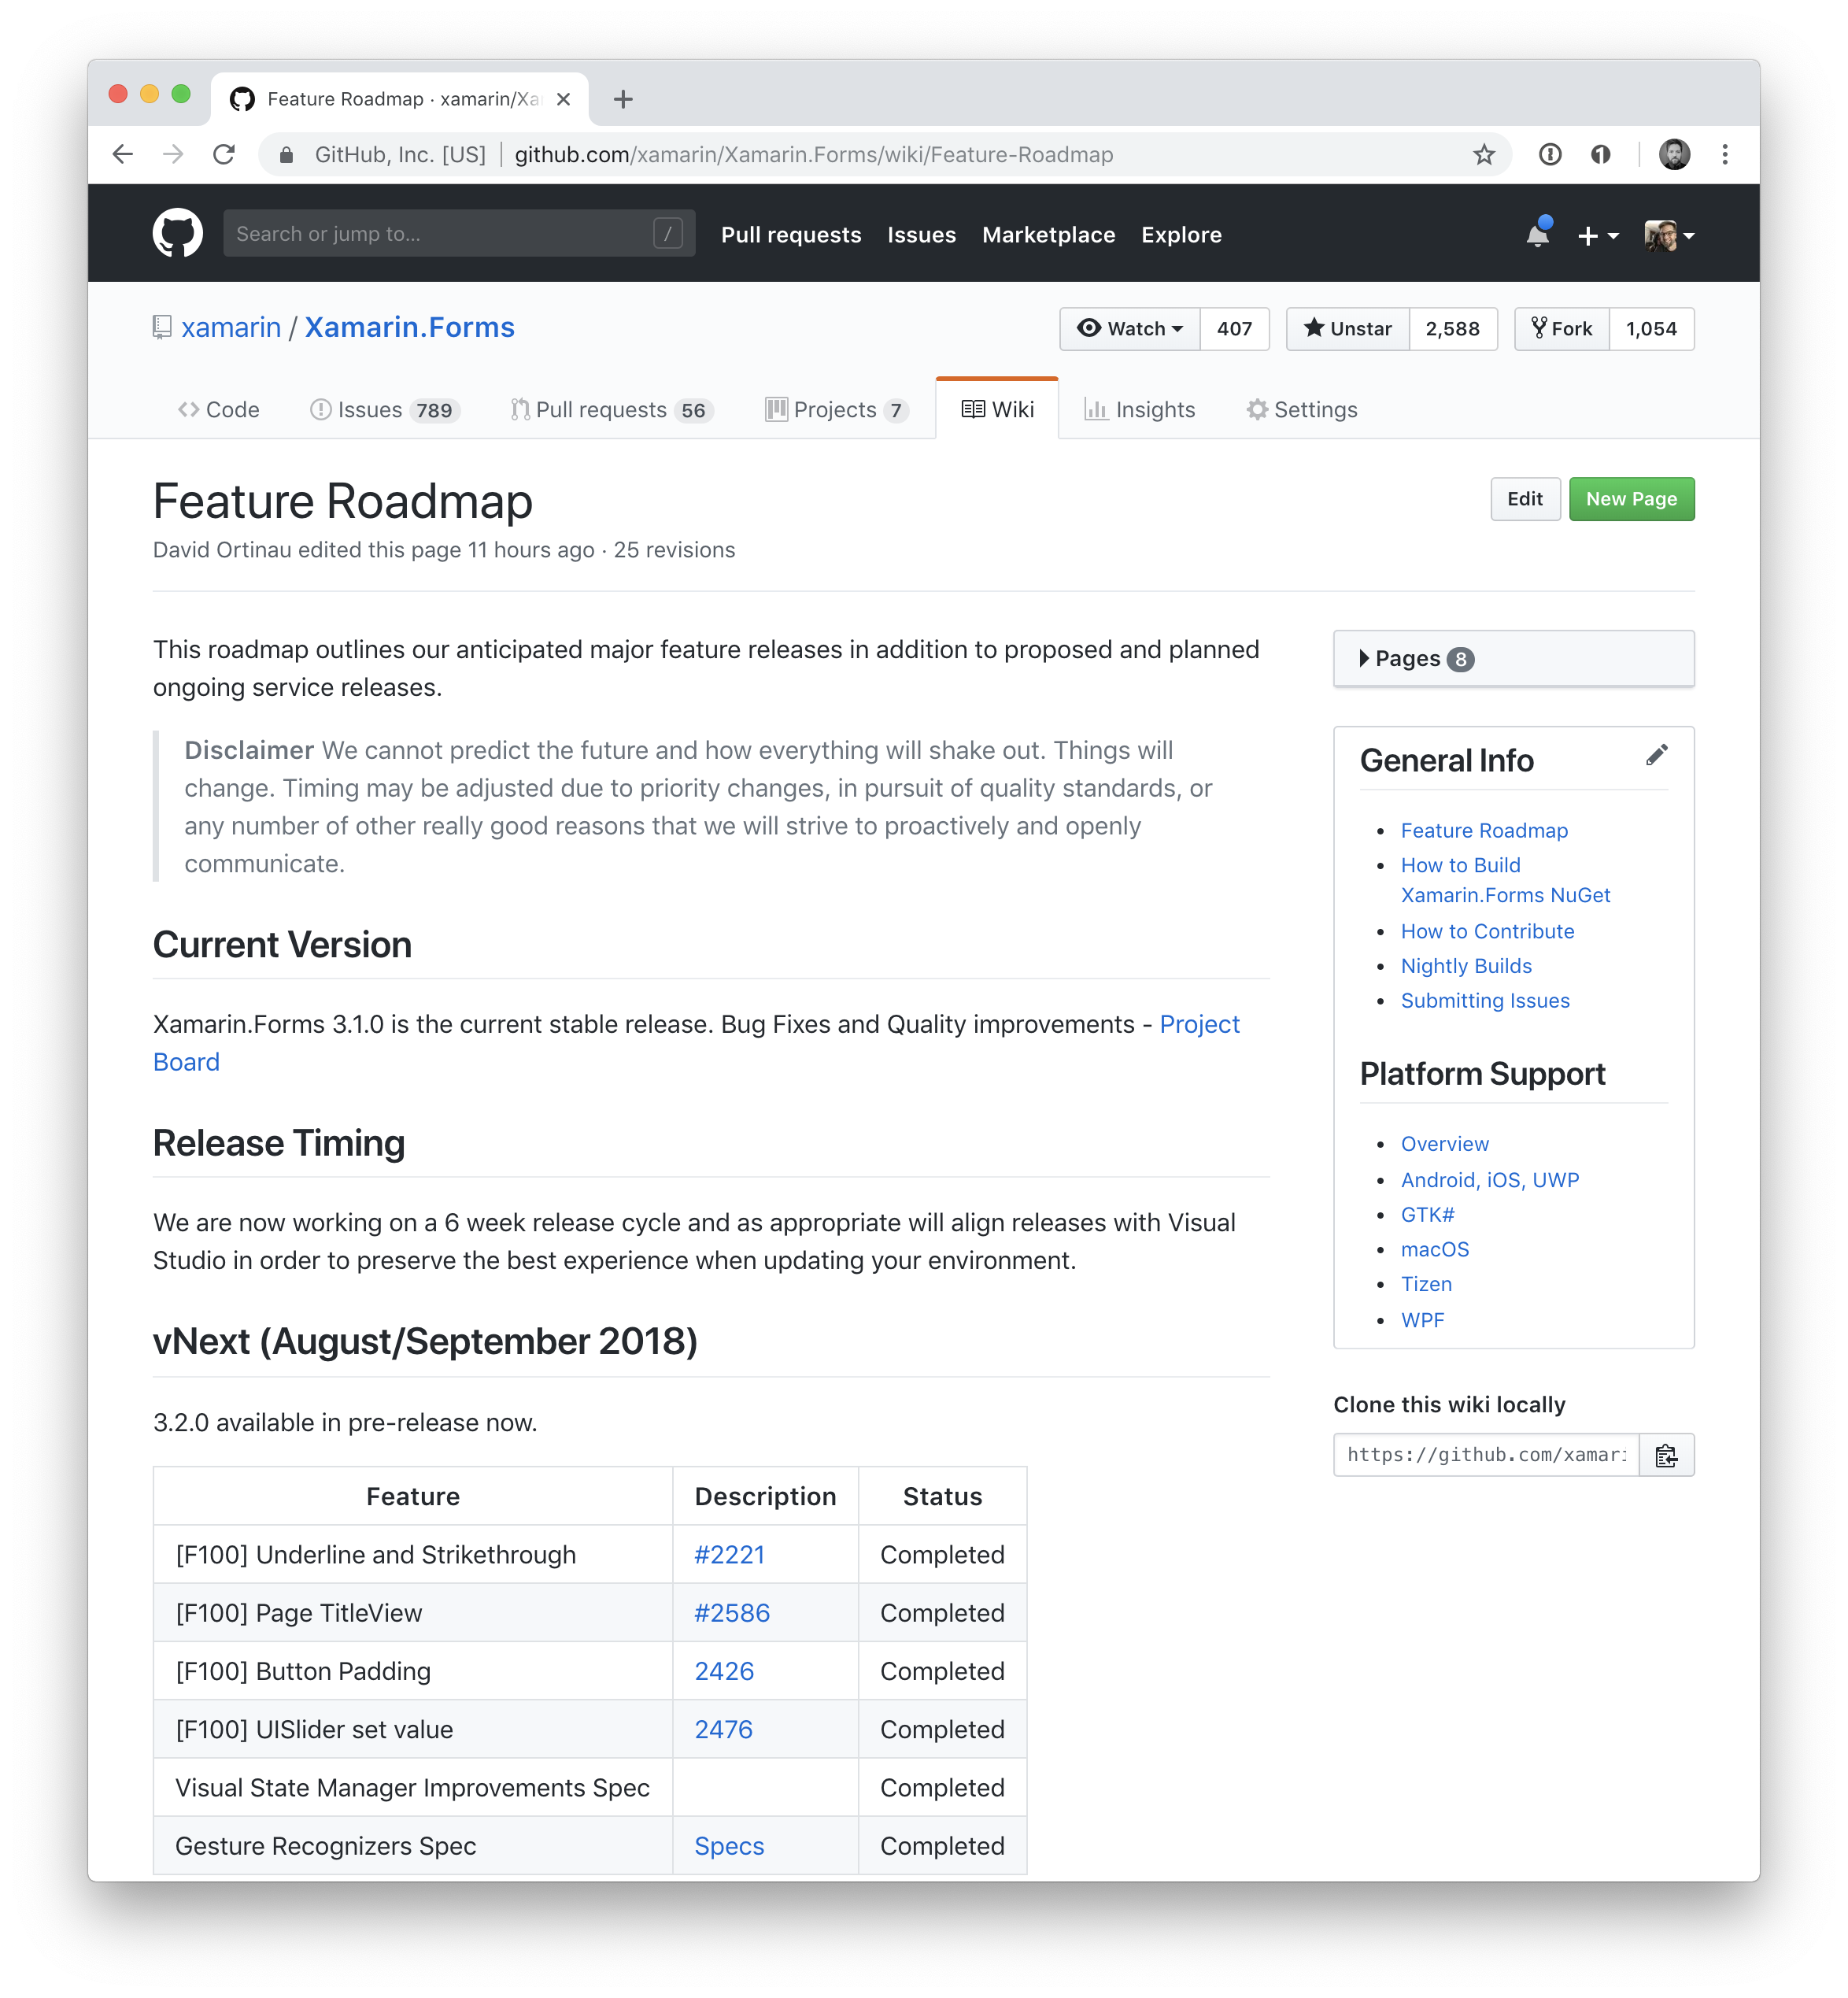

Slide 45
Join the Fun!
https://blog.xamarin.com/beginners-guide-contributing-xamarin-forms/
https://blog.xamarin.com/debugging-xamarin-forms/

Slide 46
Thanks!
matteo.pagani@microsoft.com
@qmatteoq

